Slide 1
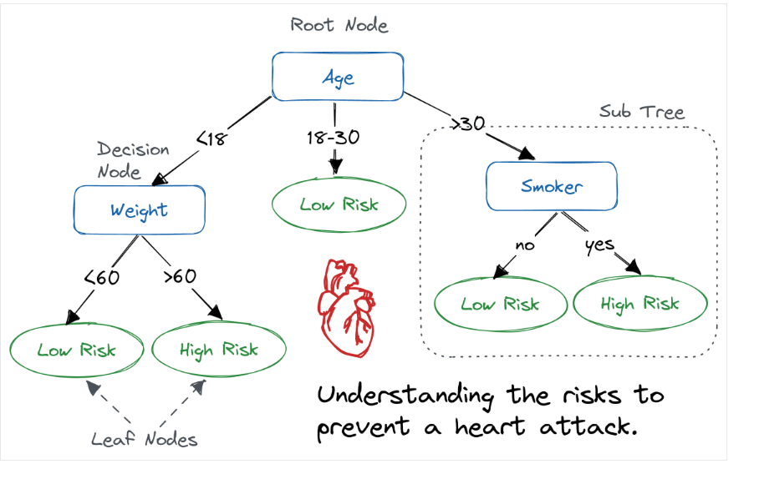
Decision Tree:
Following is an example of decision tree that is already constructed: Root node starts with age, then in left node it
decides based on wt. Right node decides based on smoker.
Features are age, wt. and smoker. The response variable is High/Low risk of heart attack

Slide 2
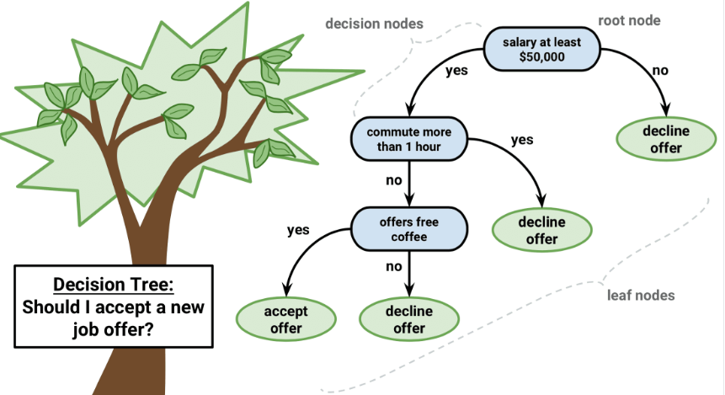
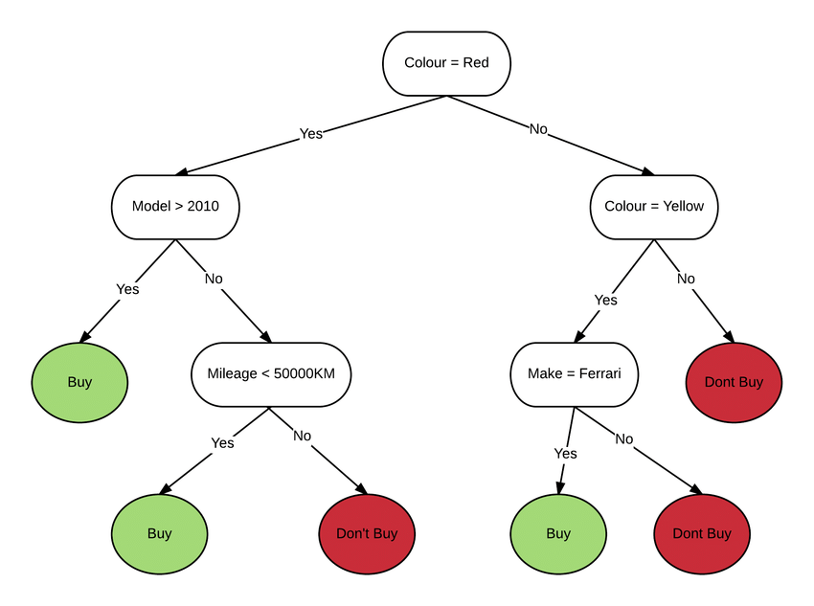
Another example: Buy or Not to Buy
Another example: Accept or Decline

Slide 3
Decision Tree:
Interpretable by humans
Have sufficiently complex decision boundaries. So, can easily capture Non-linear patterns
Decision boundaries are locally linear, each component of the decision boundary is simple to describe mathematically.
Formally, a decision tree model is one in which the final outcome of the model is based on a series of comparisons of the values of predictors against threshold values.
In a graphical representation (flow chart), the internal nodes of the tree represent attribute testing , branching in the next level is determined by attribute value , leaf nodes represent class assignments

Slide 4
How do you determine which feature to use when splitting?
color | wt | shape | sweet | fruit_type
red | 0.1 | round | y | apple
red | 0.2 | round | y | apple
green | 0.1 | round | n | apple
green | 0.5 | elongated | y | banana
yellow | 0.6 | elongated | n | banana
black | 0.1 | elongated | y | banana
yellow | 0.6 | elongated | n | banana
green | 0.5 | elongated | y | banana
Here target variable(aka, response variable) is fruit_type: apple or banana
If u notice, the shape is best feature that determines the type of fruit. So this feature has most information gain among all.
Feature sweet has almost no correlation with fruit_type
So start by asking if the fruit shape is elongated or round, we can quickly determine the type of fruit. So this would be good candidate for splitting.
The wt could also indicate the type of fruit. If wt < 0.3, then fruit_type is apple, else it is banana. This could be another candidate for splitting

Slide 5
Visual concept of Information Gain
10 positive labels (apple)
9 negative labels (not-apple)
10 positive labels (apple)
9 negative labels (not-apple)
Ask a question1
e.g.: Is color green
Ask a question2
e.g.: Is wt > .2
5 positive labels
4 negative labels
5 positive labels
5 negative labels
8 positive labels
1 negative labels
2 positive labels
8 negative labels
Less Information Gain from Question1
High Information Gain from Question2

Slide 6

Math of Decision tree:
Root node consist of all data points.
You split each node based on numerical value of Information Gain for a certain feature:
A feature/attribute A with d distinct values divides the training set E into subsets E1,...,Ed. Each subset Ek has pk positive examples and nk negative examples.
Another def.: Info. Gain = Entropy before split – Entropy after split
= Entropy of Parent – Avg. Entropy of child nodes
At each node you find the IG of each feature, and then choose the feature to use for splitting that has highest IG.
Example next->

Slide 7
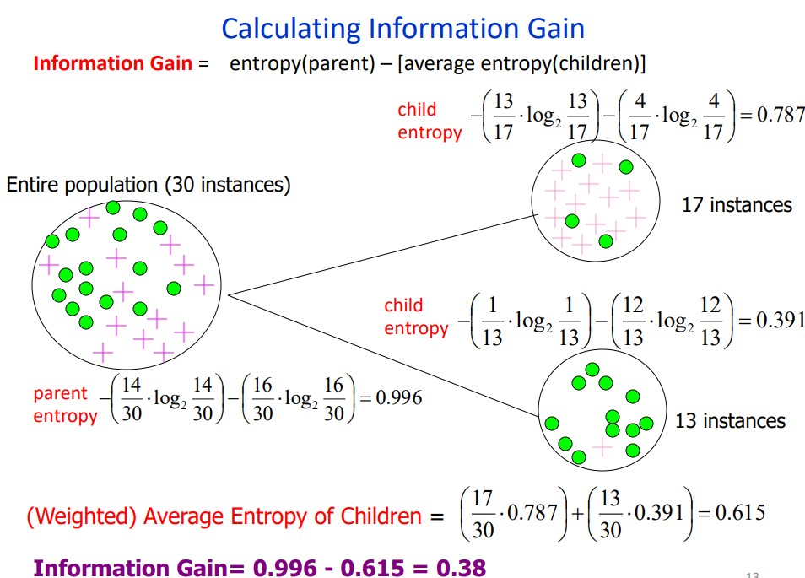
Example of calculating IG:
Source: https://courses.cs.washington.edu/courses/cse446/20wi/Lecture3/03_InformationGain.pdf

Slide 8
Steps to calculate IG(p1):
ID | Age Group | Smoking Status | Exercise Habit | Heart Disease (Label)
1 | Younger (<40) | Smoker | Regular | Positive
2 | Younger (<40) | Smoker | Regular | Positive
3 | Younger (<40) | Smoker | Regular | Positive
4 | Younger (<40) | Smoker | No Exercise | Positive
5 | Younger (<40) | Smoker | No Exercise | Positive
6 | Younger (<40) | Non-Smoker | Regular | Positive
7 | Younger (<40) | Non-Smoker | Regular | Positive
8 | Younger (<40) | Non-Smoker | Regular | Positive
9 | Younger (<40) | Non-Smoker | No Exercise | Positive
10 | Younger (<40) | Non-Smoker | No Exercise | Positive
11 | Younger (<40) | Smoker | No Exercise | Negative
12 | Younger (<40) | Smoker | No Exercise | Negative
13 | Younger (<40) | Non-Smoker | No Exercise | Negative
14 | Younger (<40) | Non-Smoker | No Exercise | Negative
15 | Younger (<40) | Non-Smoker | No Exercise | Negative
16 | Older (≥40) | Smoker | No Exercise | Positive
17 | Older (≥40) | Smoker | No Exercise | Positive
18 | Older (≥40) | Non-Smoker | Regular | Positive
19 | Older (≥40) | Non-Smoker | Regular | Positive
20 | Older (≥40) | Smoker | No Exercise | Negative
21 | Older (≥40) | Smoker | No Exercise | Negative
22 | Older (≥40) | Smoker | No Exercise | Negative
23 | Older (≥40) | Smoker | No Exercise | Negative
24 | Older (≥40) | Smoker | No Exercise | Negative
25 | Older (≥40) | Smoker | No Exercise | Negative
26 | Older (≥40) | Smoker | No Exercise | Negative
27 | Older (≥40) | Non-Smoker | No Exercise | Negative
28 | Older (≥40) | Non-Smoker | No Exercise | Negative
29 | Older (≥40) | Non-Smoker | No Exercise | Negative
30 | Older (≥40) | Non-Smoker | No Exercise | Negative
This is an example related to predicting heart disease in patients. At this node, there are 3 features where split could be made:
1) Age Group Split: Older individuals are more prone to heart disease.
2) Smoking Status Split: Smokers have a higher risk.
3) Exercise Habit Split: Lack of exercise increases risk significantly.
Lets determine on which feature the split should be made.

Slide 9
Steps to calculate IG(p2):
Step 1: Calculate Entropy of the Parent Node
positive cases(Has heart disease) = 14
negative cases(Has no heart disease) = 16
Total case = 30
Entropy of parent
= Entropy before split
= −[ (14/30 * ​log​(14/30)​ + 16/30*​log(16/30​) ]
= −(0.466×−1.099+0.533×−0.912) = 0.999
This is almost 1…so high entropy.

Slide 10
Steps to calculate IG(p3):
Step 2: Perform 3 Different Splits & Calculate Information Gain
Split 1: Based on Age Group (Younger vs. Older)
We split the data based on whether a person is younger (<40 years) or older (≥40 years).
Age Group | Positive Cases | Negative Cases | Total
Younger (<40) | 10 | 5 | 15
Older (≥40) | 4 | 11 | 15
Entropy of younger Node
= −[10/15 * ​log​(10/15)​+5/15*​log(5/15​) ]
= −(0.666×−0.585+0.333×−1.585) = 0.918
Entropy of older Node
= −[4/15 * ​log​(4/15)​+11/15*​log(11/15​) ]
= −(0.266×−1.907+0.733×−0.448) = 0.836
Entropy after split on Age group
= (15/30​×0.918)+(15/30​×0.836) = 0.877
Info gain = Entropy before split - Entropy after split
= Entropy of parent - Entropy after split
= 0.999−0.877= 0.122

Slide 11
Steps to calculate IG(p4):
Split 2: Based on Smoking Status (Smoker vs. Non-Smoker)
We split the data based on whether a person is smoker or not
Smoking Status | Positive Cases | Negative Cases | Total
Smoker | 6 | 12 | 18
Non-Smoker | 8 | 4 | 12
Entropy of smoker Node
= −[6/18 * ​log​(6/18)​+12/18*​log(12/18​) ]
= −(0.333×−1.585+0.666×−0.585) = 0.918
Entropy of non smoker Node
= −[8/12 * ​log​(8/12)​+4/12*​log(4/12​) ] = 0.918
Entropy after split on smoking status
= (18/30​ × 0.918) + (12/30​ × 0.918)=0.918
Info gain = Entropy before split - Entropy after split
= Entropy of parent - Entropy after split
= 0.999 − 0.918 = 0.081

Slide 12
Steps to calculate IG(p5):
Split 3: Based on Exercise Habit (Regular vs. No Exercise)
We split the data based on exercise habit
Exercise Habit | Positive Cases | Negative Cases | Total
Regular | 9 | 3 | 12
No Exercise | 5 | 13 | 18
Entropy of regular-exercise Node
= −[9/12 * ​log​(9/12)​+3/12*​log(3/12​) ] = 0.811
Entropy of no-exercise Node
= −[5/18 * ​log​(5/18)​+13/18*​log(13/18​) ] = 0.850
Entropy after split on exercise habit status
= (12/30​×0.811) + (18/30​×0.850) = 0.835
Info gain = Entropy before split - Entropy after split
= Entropy of parent - Entropy after split
= 0.999 − 0.835 = 0.164
Split Criterion | Information Gain (IG)
Age Group (Young vs. Old) | 0.122
Smoking Status (Smoker vs. Non-Smoker) | 0.081
Exercise Habit (Regular vs. No Exercise) | 0.164
Conclusion: The best attribute for the split is Exercise Habit (IG = 0.164) as it gives the highest Information Gain.

Slide 13
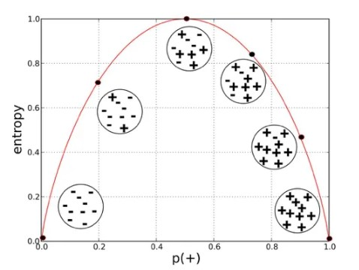
How is entropy related to probability of positive class ?

Slide 14
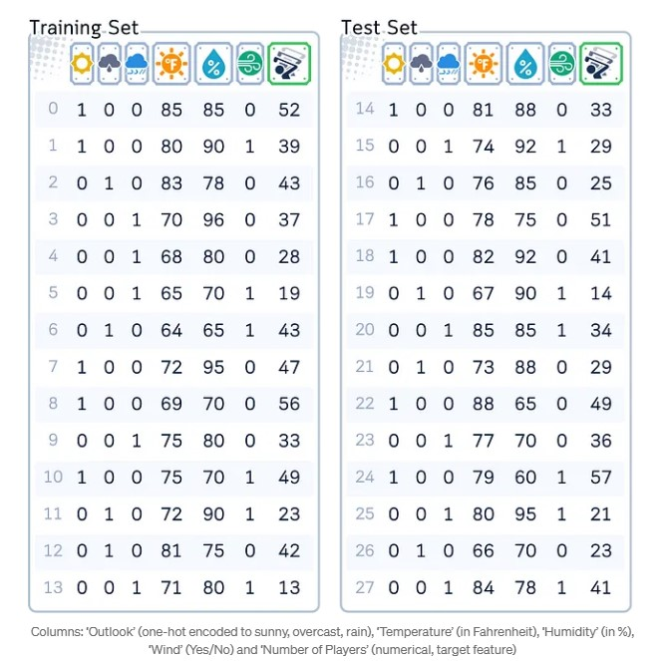
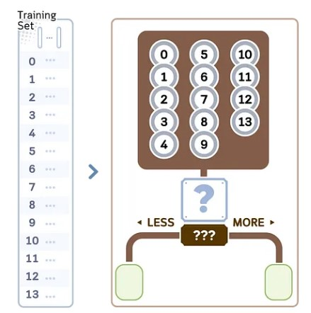
Decision Tree Regressor(p1)
Source:
https://medium.com/data-science/decision-tree-regressor-explained-a-visual-guide-with-code-examples-fbd2836c3bef
A Decision Tree for regression is a model that predicts numerical values using a tree-like structure (See jupyter notebook for the code)
Training Steps
We will explore the regression part in the decision tree algorithm CART (Classification and Regression Trees). We would use the data shown in right.
It builds binary trees and typically follows these steps:
1.Begin with all training samples in the root node.
See jupyter notebook for code

Slide 15
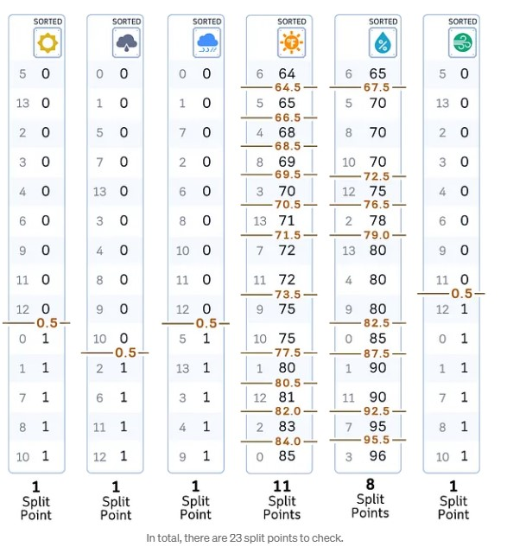
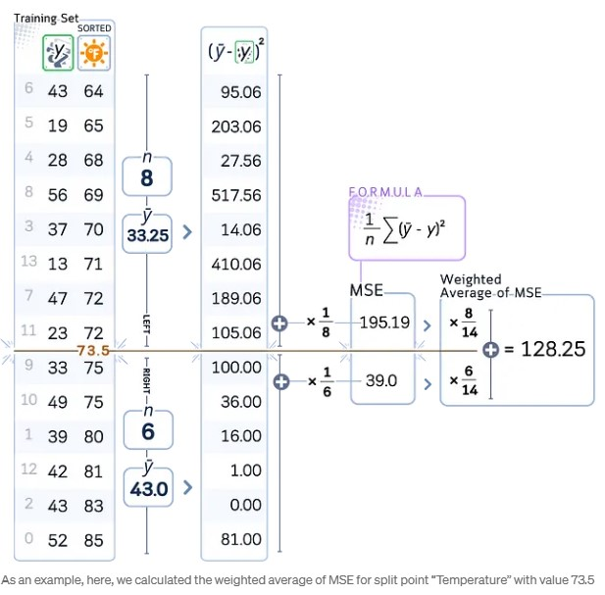
Decision Tree Regressor(p2)
2.For each feature in the dataset: a. Sort the feature values in ascending order. b. Consider all midpoints between adjacent values as potential split points.
3. For each potential split point: a. Calculate the mean squared error (MSE) of the current node. b. Compute the weighted average of errors for the resulting split.
(43 – 33.25)^2 = 95.06
(19 – 33.25)^2 = 203.06

Slide 16
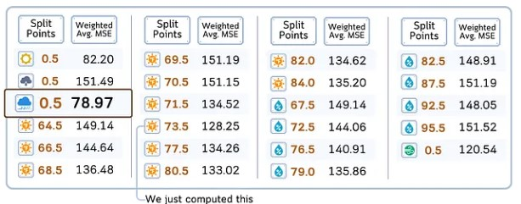
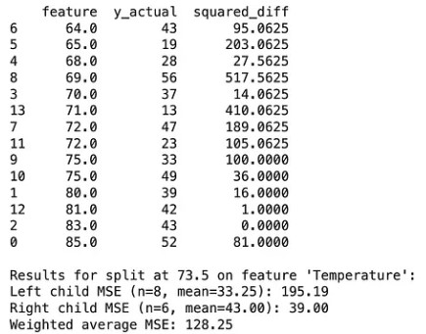
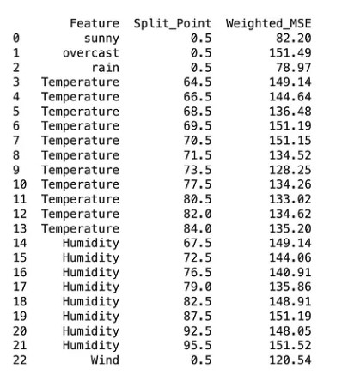
Decision Tree Regressor(p3)
4. After evaluating all features and split points, select the one with lowest weighted average of MSE.
See jupyter notebook for code
See jupyter notebook for code

Slide 17
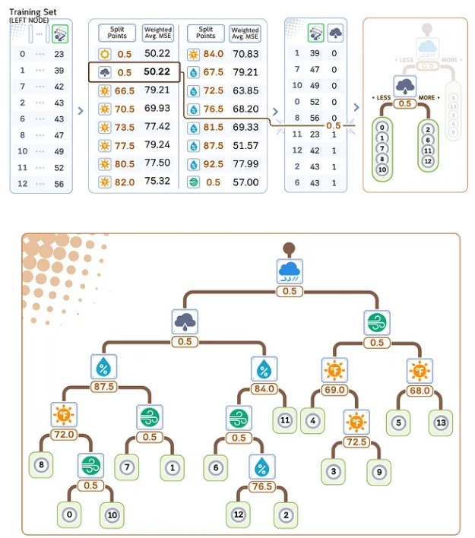
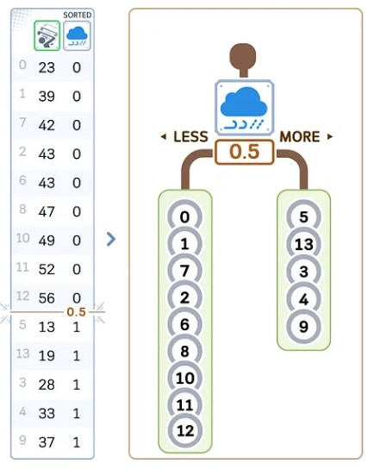
Decision Tree Regressor(p4)
5. Create two child nodes based on the chosen feature and split point: - Left child: samples with feature value <= split point - Right child: samples with feature value > split point
6. Recursively repeat steps 2–5 for each child node. (Continue until a stopping criterion is met.)

Slide 18
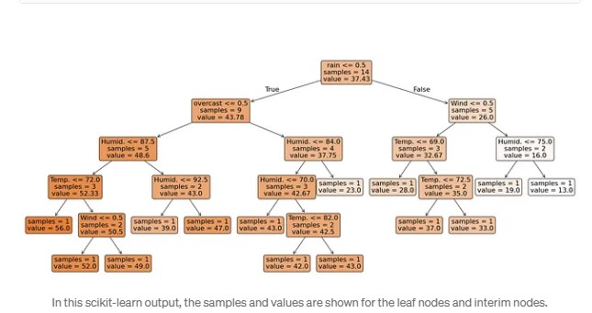
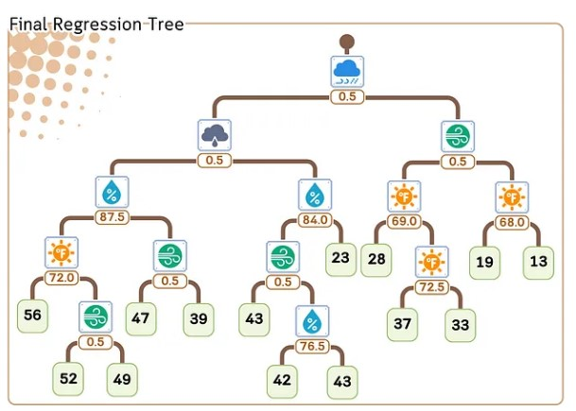
Decision Tree Regressor(p5)
7. At each leaf node, assign the average target value of the samples in that node as the prediction.
See jupyter notebook for code

Slide 19
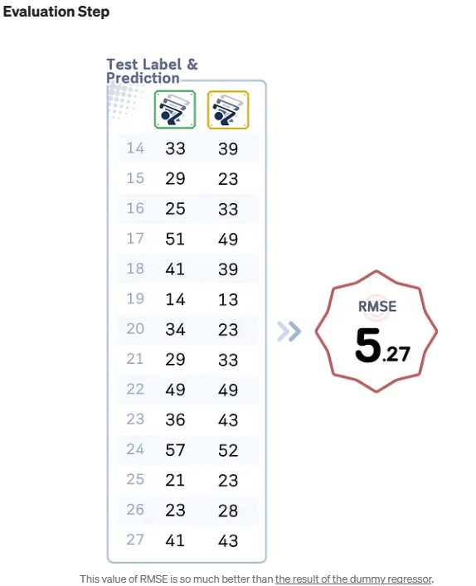
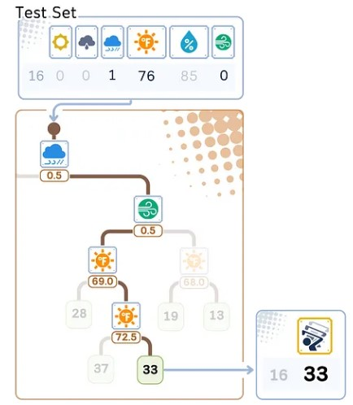
Decision Tree Regressor(p6)
Regression/Prediction Step
Here’s how a regression tree makes predictions for new data: 1. Start at the top (root) of the tree. 2. At each decision point (node): - Look at the feature and split value. - If the data point’s feature value is smaller or equal, go left. - If it’s larger, go right. 3. Keep moving down the tree until you reach the end (a leaf). 4. The prediction is the average value stored in that leaf.
See jupyter notebook for code

Slide 20
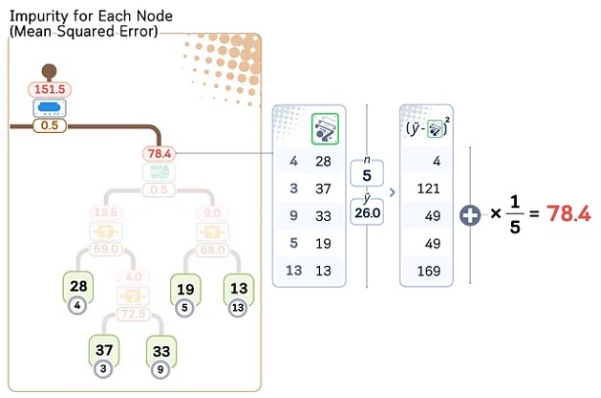
Decision Tree Regressor(p7)
Pre-pruning vs Post-pruning
After building the tree, the only thing we need to worry about is the method to make the tree smaller to prevent overfitting. In general, the method of pruning can be categorized as:
Pre-pruning
Pre-pruning, also known as early stopping, involves halting the growth of a decision tree during the training process based on certain predefined criteria. This approach aims to prevent the tree from becoming too complex and overfitting the training data. Common pre-pruning techniques include:
Maximum depth: Limiting how deep the tree can grow.
Minimum samples for split: Requiring a minimum number of samples to justify splitting a node.
Minimum samples per leaf: Ensuring each leaf node has at least a certain number of samples.
Maximum number of leaf nodes: Restricting the total number of leaf nodes in the tree.
Minimum impurity decrease: Only allowing splits that decrease impurity by a specified amount.
These methods stop the tree’s growth when the specified conditions are met, effectively “pruning” the tree during its construction phase.
Post-pruning
Post-pruning, on the other hand, allows the decision tree to grow to its full extent and then prunes it back to reduce complexity. This approach first builds a complete tree and then removes or collapses branches that don’t significantly contribute to the model’s performance. One common post-pruning technique is called Cost-Complexity Pruning.
Cost Complexity Pruning
Step 1: Calculate the Impurity for Each Node
For each interim node, calculate the impurity (MSE for regression case). We then sorted this value from the lowest to highest.

Slide 21
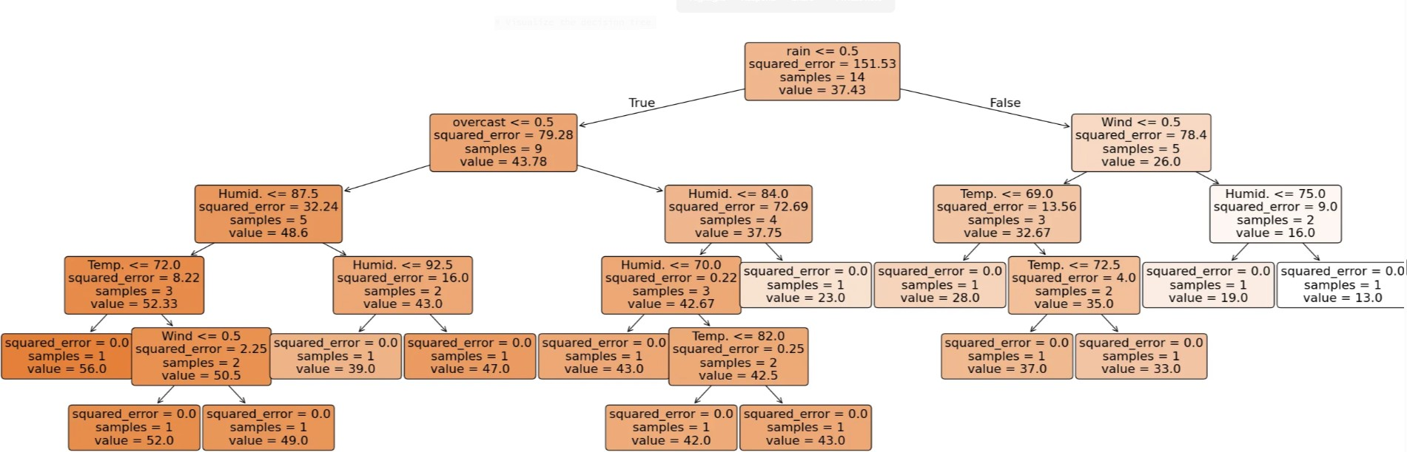
Decision Tree Regressor(p8)
In this scikit learn output, the impurity are shown as “squared_error” for each nodes.
See jupyter notebook for code

Slide 22
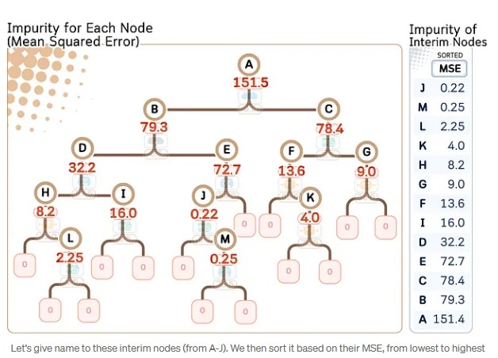
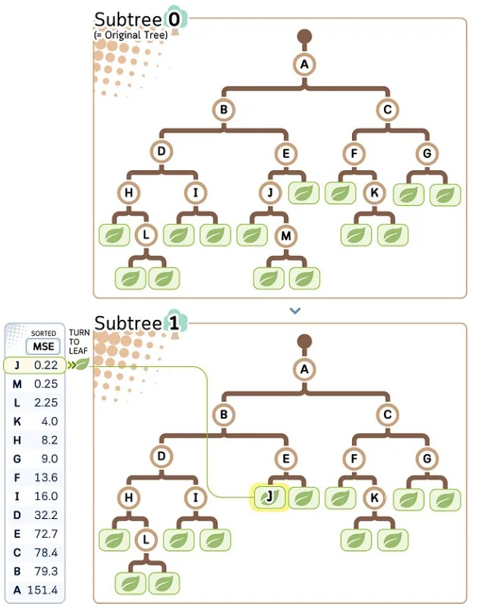
Decision Tree Regressor(p9)
Step 2: Create Subtrees by Trimming The Weakest Link
The goal is to gradually turn the interim nodes into leaves starting from the node with the lowest MSE (= weakest link). We can create a path of pruning based on that.

Slide 23
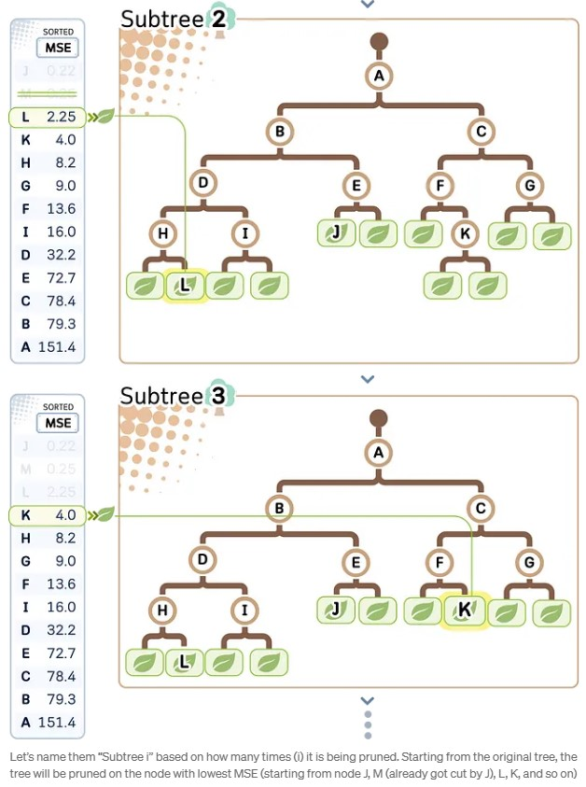
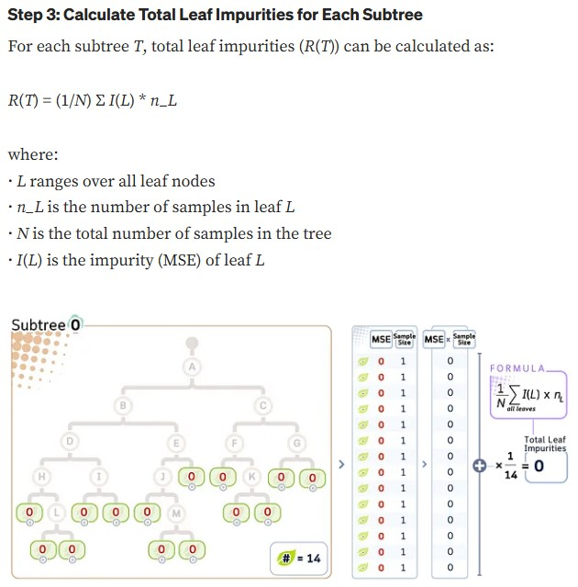
Decision Tree Regressor(p10)

Slide 24
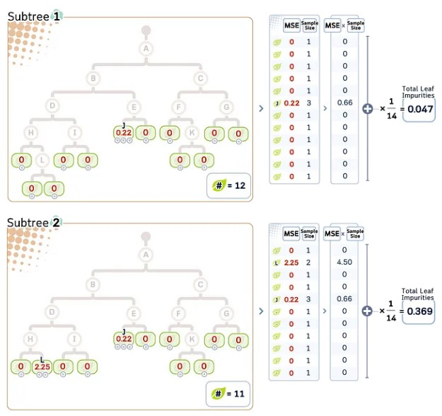
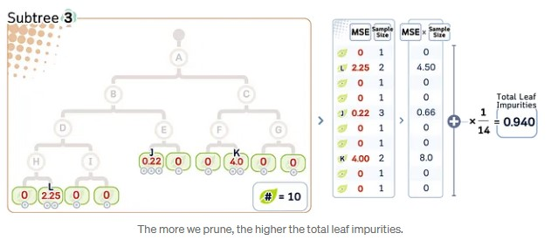
Decision Tree Regressor(p11)

Slide 25
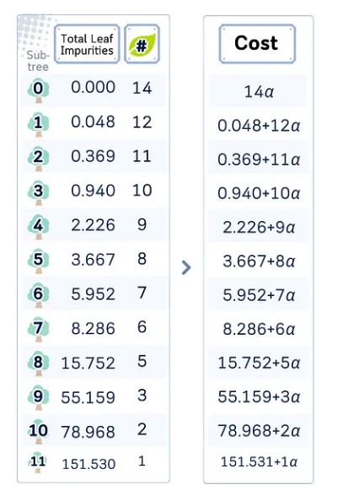
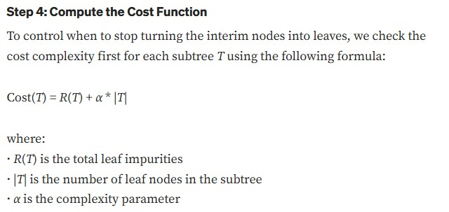
Decision Tree Regressor(p12)

Slide 26
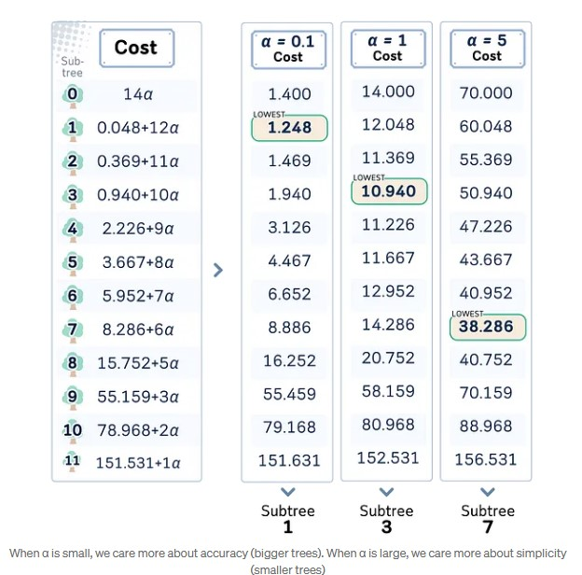
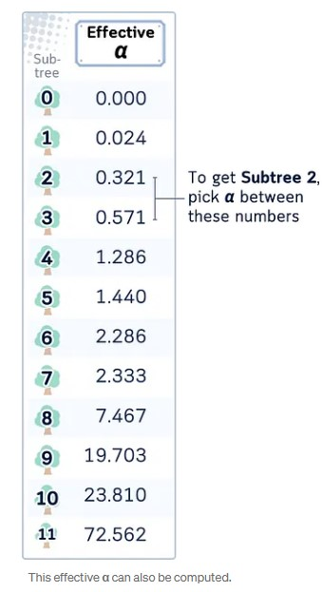
Decision Tree Regressor(p13)
Step 5: Select the Alpha
The value of alpha control which subtree we will end up with. The subtree with the lowest cost will be the final tree.
While we can freely set the α, in scikit-learn, you can also get the smallest value of α to obtain a particular subtree. This is called effective α.

Slide 27
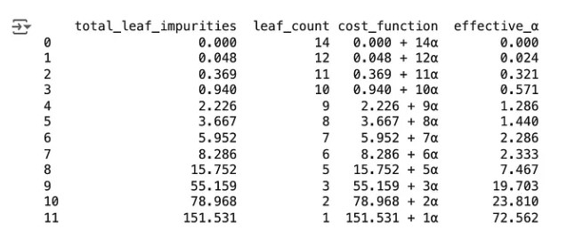
Decision Tree Regressor(p14)
Final Remarks
Pre-pruning methods are generally faster and more memory-efficient, as they prevent the tree from growing too large in the first place.
Post-pruning can potentially create more optimal trees, as it considers the entire tree structure before making pruning decisions. However, it can be more computationally expensive.
Both approaches aim to find a balance between model complexity and performance, with the goal of creating a model that generalizes well to unseen data. The choice between pre-pruning and post-pruning (or a combination of both) often depends on the specific dataset, the problem at hand, and of course, computational resources available.
In practice, it’s common to use a combination of these methods, like applying some pre-pruning criteria to prevent excessively large trees, and then using post-pruning for fine-tuning the model’s complexity.
See jupyter notebook for code

Slide 28
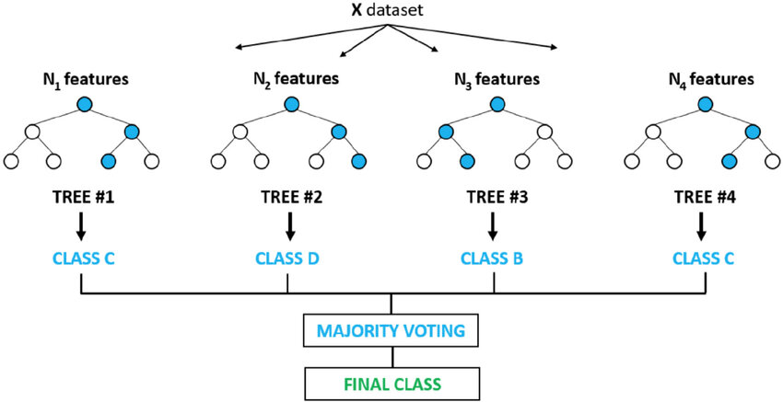
Random Forest Classifier(p1)
Random forest, an ensemble learning method, merges the outputs of numerous decision trees to produce a single outcome.
It is suitable for both classification and regression tasks.
It can handle the data set containing continuous variables, as in the case of regression, and categorical variables, as in the case of classification.
Steps Involved in Random Forest Algorithm
Step 1: In this model, we select a subset of data points and a subset of features to construct each decision tree. Simply put, we take n random records and m features from a dataset containing k records.
Step 2: We construct individual decision trees for each sample.
Step 3: Each decision tree will generate an output.
Step 4: We consider the final output based on Majority Voting for classification and Averaging for regression, respectively.

Slide 29
Random Forest Classifier(p2)
Random Forest Classifier Parameters
n_estimators: Number of trees in the forest. More trees generally lead to better performance, but at the cost of computational time.Start with a value of 100 and increase as needed.
max_depth: Maximum depth of each tree. Deeper trees can capture more complex patterns, but also risk overfitting.Experiment with values between 5 and 15, and consider lower values for smaller datasets.
max_features: Number of features considered for splitting at each node. A common value is ‘sqrt’ (square root of the total number of features). Adjust based on dataset size and feature importance.
criterion: Function used to measure split quality (‘gini’ or ‘entropy’).Gini impurity is often slightly faster, but both are generally similar in performance.
min_samples_split: Minimum samples required to split a node. Higher values can prevent overfitting, but too high can hinder model complexity. Start with 2 and adjust as needed.
min_samples_leaf: Minimum samples required to be at a leaf node. Similar to min_samples_split, but focused on leaf nodes. Start with 1 and adjust as needed.
Disadvantages of Random Forest Classifier:
RF can be computationally expensive due to the construction of multiple decision trees.
The ensemble nature makes it challenging to interpret the reasoning behind individual predictions compared to a single decision tree.
In imbalanced datasets, RF may be biased toward the majority class, impacting the predictive performance for minority classes.

Slide 30
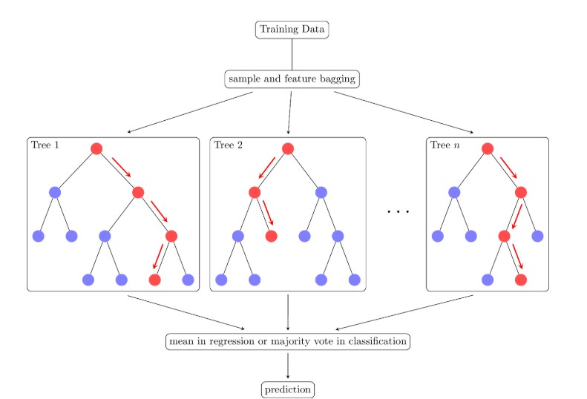
Random forest regressor(p1)
Applications of Random Forest Regression
Predicting continuous numerical values: Predicting house prices, stock prices or customer lifetime value.
Identifying risk factors: Detecting risk factors for diseases, financial crises or other negative events.
Handling high-dimensional data: Analyzing datasets with a large number of input features.
Capturing complex relationships: Modeling complex relationships between input features and the target variable.

Slide 31
Random forest regressor(p2)
Advantages of RF Regression
Handles Non-Linearity:
Reduces Overfitting: By combining multiple decision trees and averaging predictions it reduces the risk of overfitting compared to a single Dec tree.
Robust to Outliers: Random Forest is less sensitive to outliers as it aggregates the predictions from multiple trees.
Works Well with Large Datasets: It can efficiently handle large datasets and high-dimensional data without a significant loss in performance.
Handles Missing Data: Random Forest can handle missing values by using surrogate splits and maintaining high accuracy even with incomplete data.
No Need for Feature Scaling: Unlike many other algorithms Random Forest does not require normalization or scaling of the data.
Disadvantages of RF Regression
Complexity: It can be computationally expensive and slow to train especially with a large number of trees and high-dimensional data.
Less Interpretability: Since it uses many trees it can be harder to interpret compared to simpler models like linear regression or decision trees.
Memory Intensive: Storing multiple decision trees for large datasets require significant memory resources.
Overfitting on Noisy Data: While Random Forest reduces overfitting, it can still overfit if the data is highly noisy, especially with a large number of trees.
Sensitive to Imbalanced Data: It may perform poorly if the dataset is highly imbalanced like one class is significantly more frequent than another.
Difficulty in Real-Time Predictions: Due to its complexity it may not be suitable for real-time predictions especially with a large number of trees.

